Slide 1





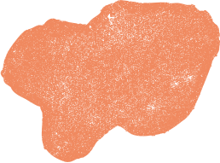
CAN YOU REMEMBER?
Let’s see if we can test your memory, and see if you can remember some of the key points from the videos.
Then you will expand on your knowledge!

Slide 2
QUESTION 1

Slide 3

Why is digestion so important for our bodies?
1
  2
  3
Digestion is the process of breaking down our food to be absorbed into the bloodstream.
Digestion helps our teeth stay healthy, and protects against cavities.
Digestion can help our lungs expand more to get more oxygen into our body.

Slide 4
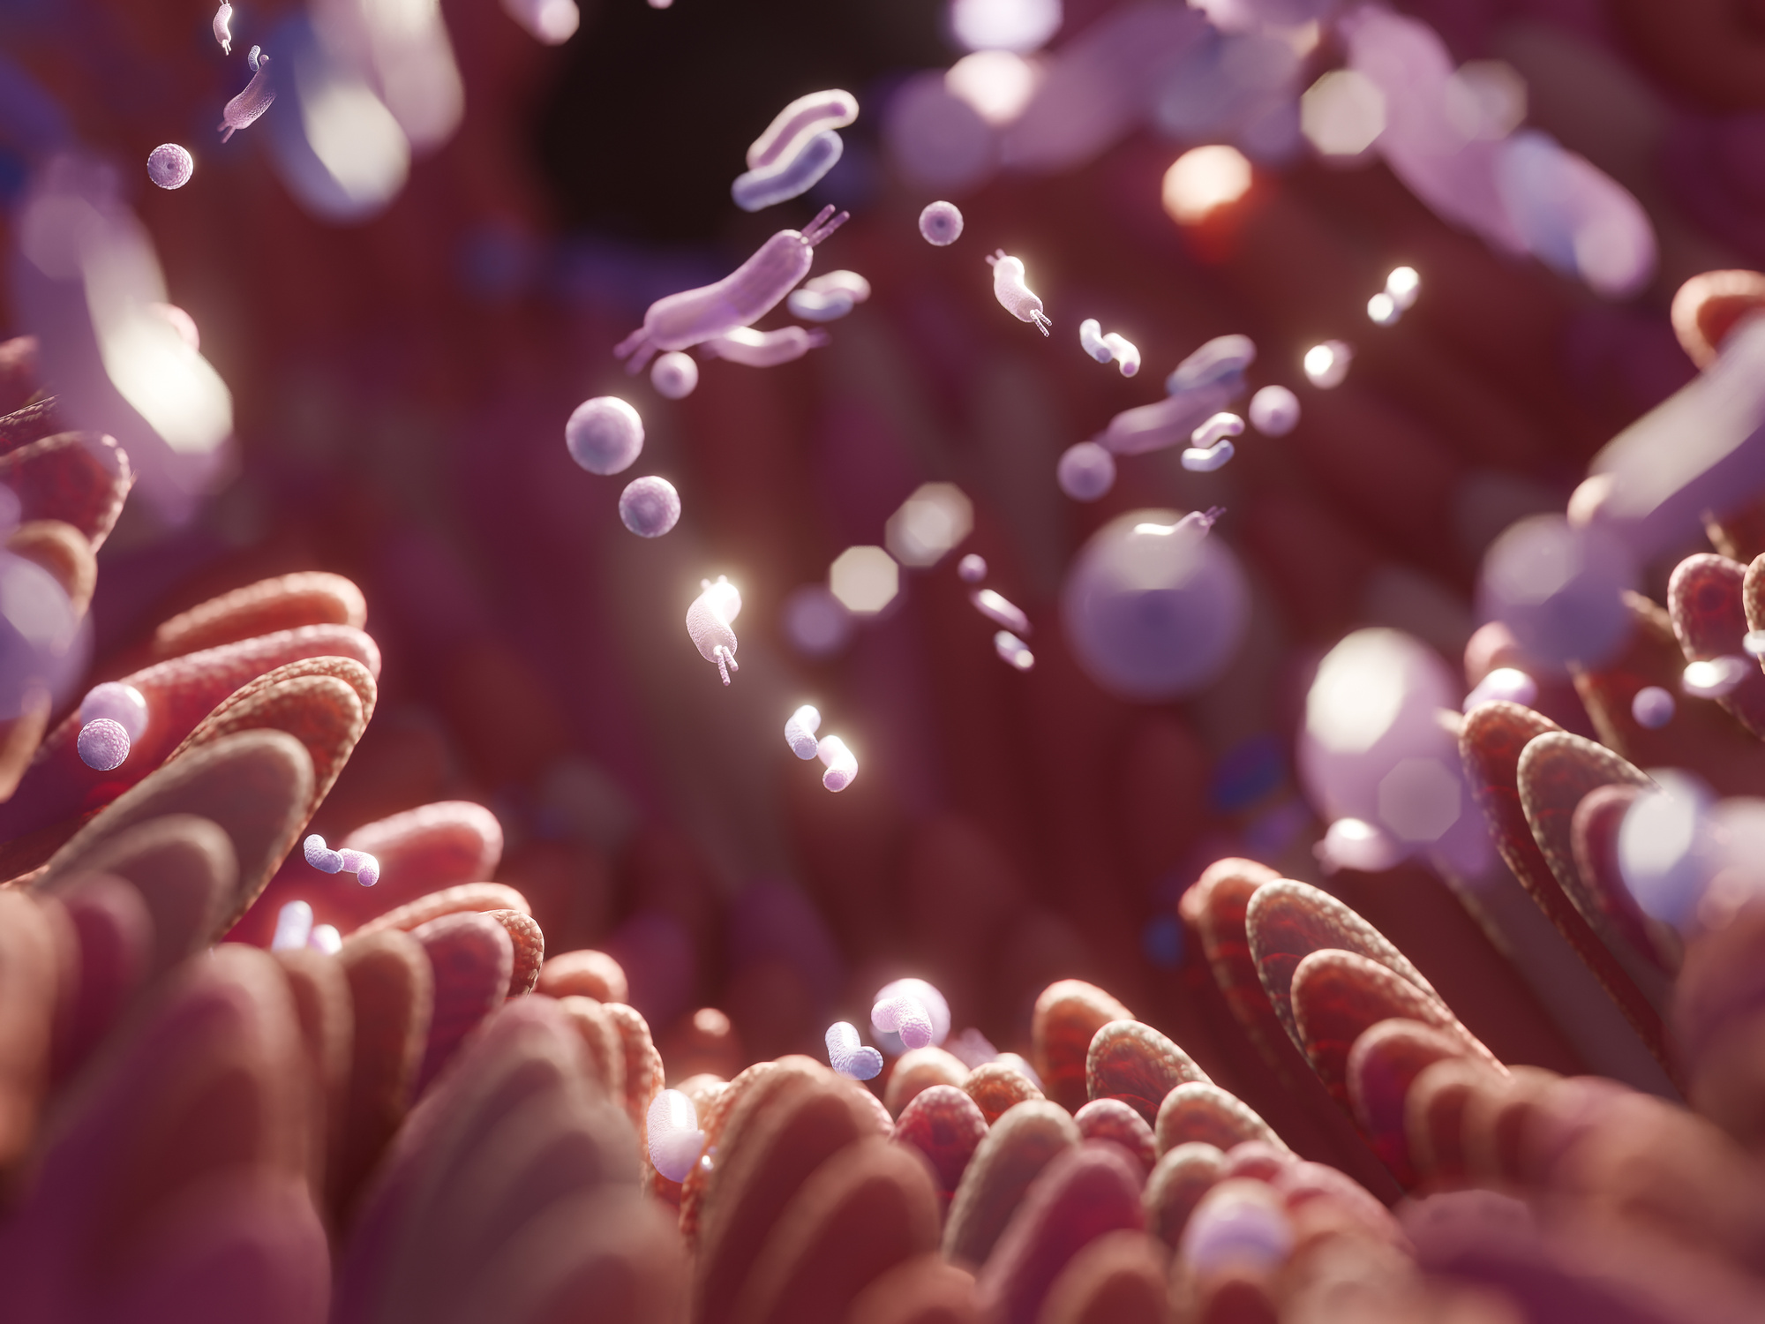

The answer is Number 3!
Well done if you got it right!
1
  2
  3
Digestion is the process of breaking down our food to be absorbed into the bloodstream.
Digestion helps our teeth stay healthy, and protects against cavities.
Digestion can help our lungs expand more to get more oxygen into our body.

Slide 5



Digestion is the process of breaking down our food to be absorbed into the bloodstream.
Digestion helps us to...
GROW
HAVE ENERGY
REPAIR CELLS
Helping us fuel our cells to grow taller and stronger through the nutrients we have eaten.
Helping by supplying energy and nutrients to our muscles, which helps us feel energised for a busy school day.
Helping nourish and repair our cells in our body. Also, the digestive system helps filter nutrients and keep toxins from entering the bloodstream.

Slide 6
QUESTION 2

Slide 7
After the mouth, what does our food travel down to get to the stomach?
1
  2
  3
The oesophagus
The small intestine
The large intestine

Slide 8

The answer is the oesophagus!
Well done if you got it right!
1
  2
  3
The oesophagus
The small intestine
The large intestine

Slide 9
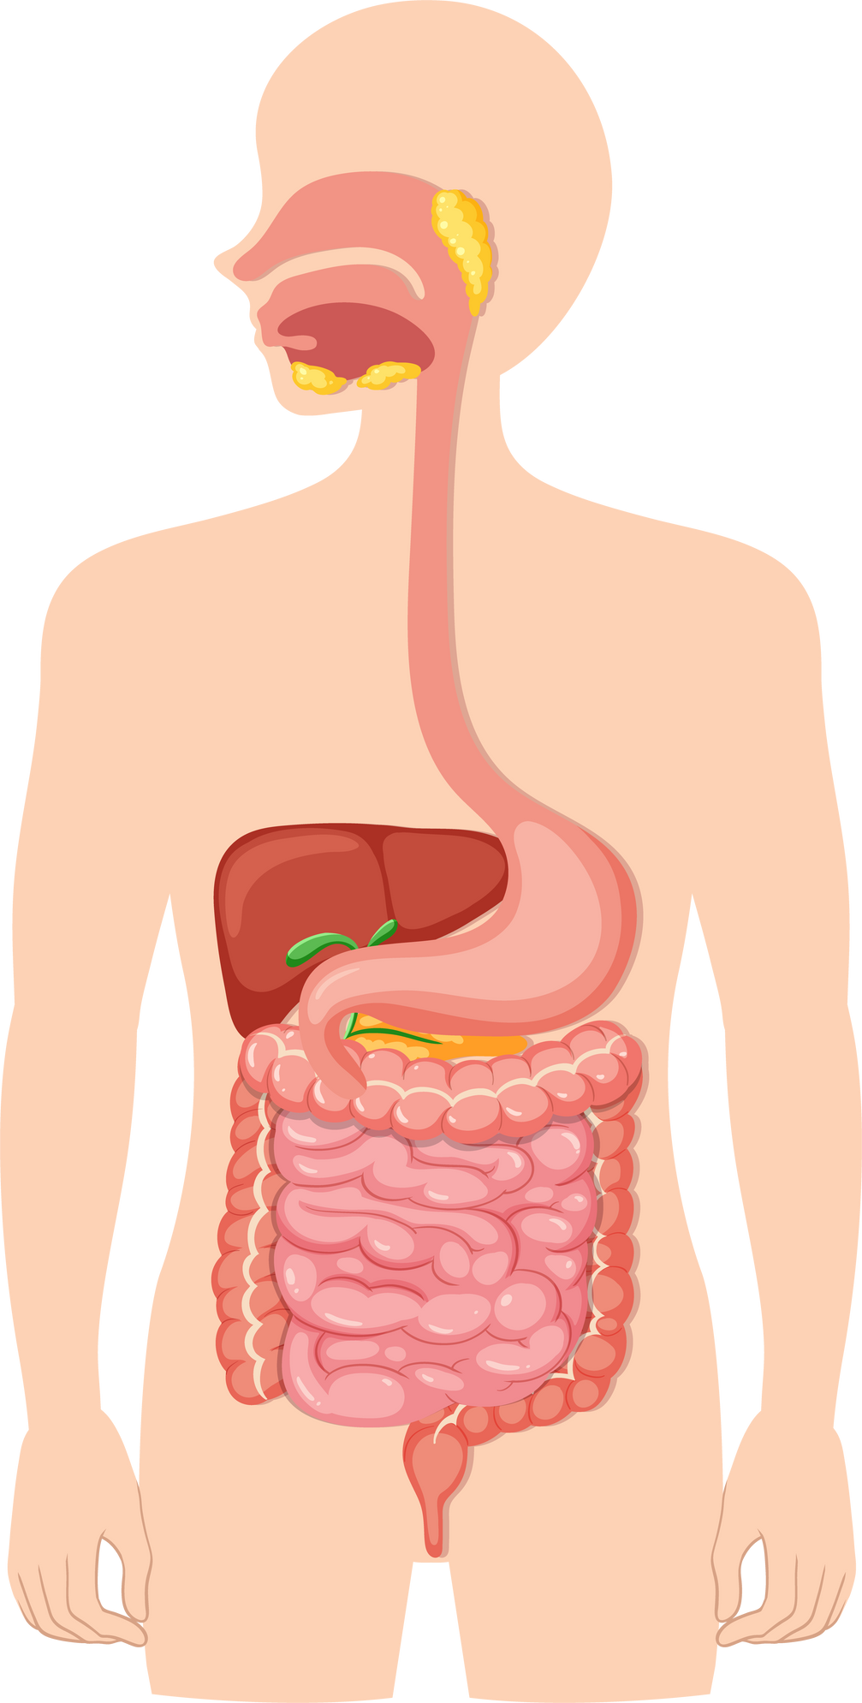










Mouth
Oesophagus
This is the route your food takes through your body!
Stomach
Small Intestine
Large Intestine
Anus

Slide 10
QUESTION 3

Slide 11
What nutrient is important for the health of your digestive system?
1
  2
  3
Protein
Fibre
Fats

Slide 12
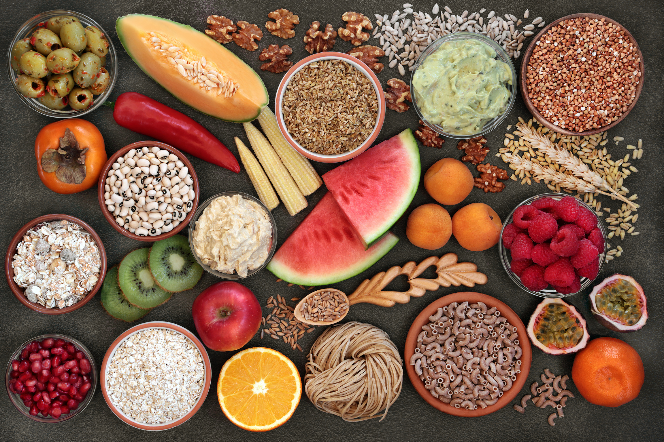
The answer is Fibre!
Well done if you got it right!
1
  2
  3
Protein
Fibre
Fats

Slide 13
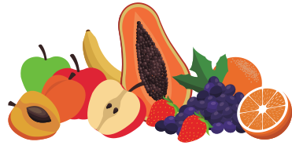
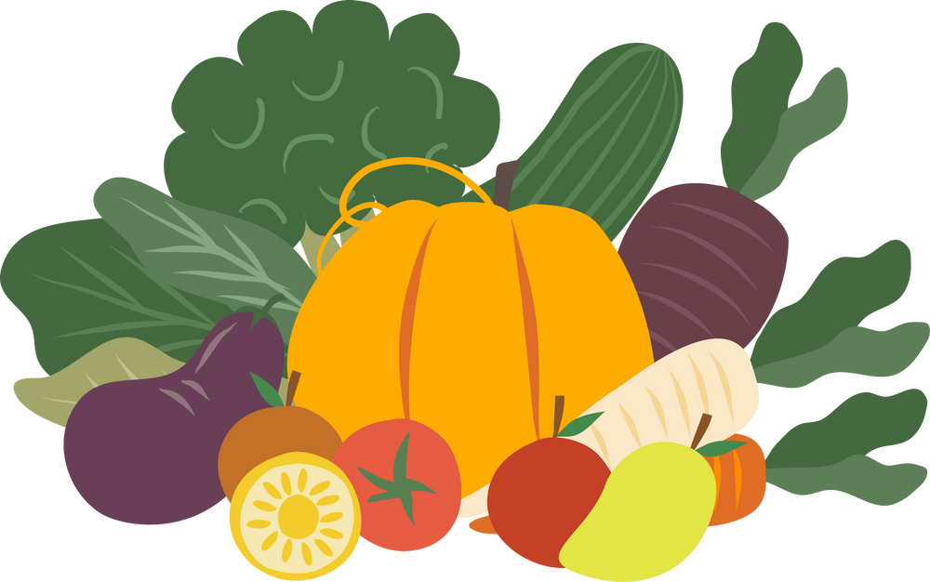
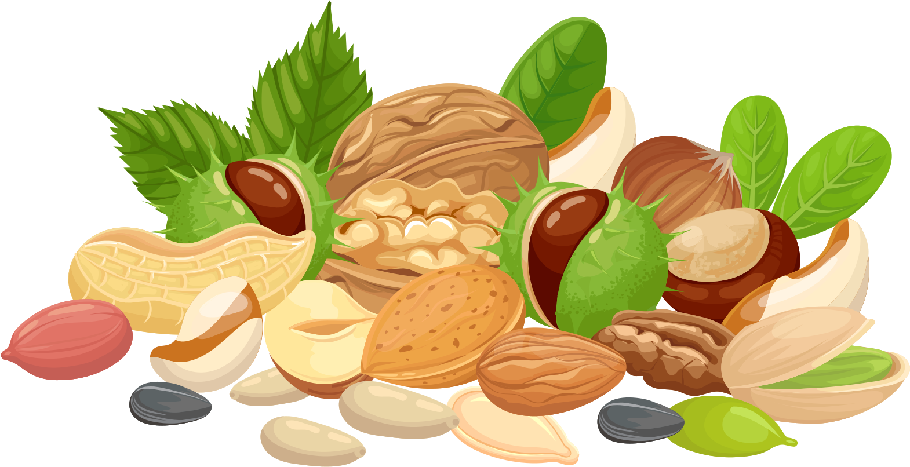

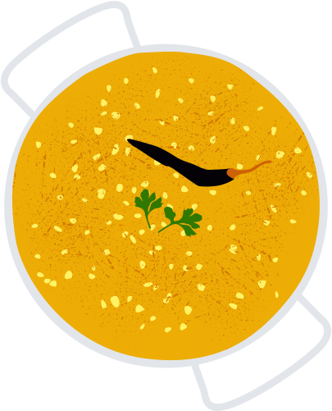
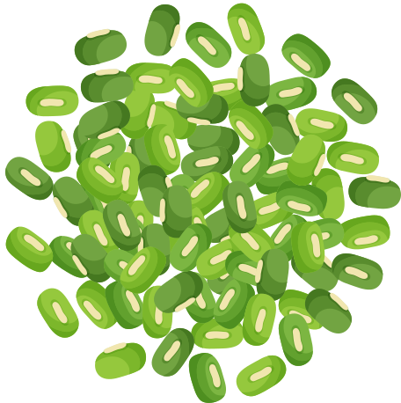





Foods high in fibre can help support your digestive system!
Fibre affects the speed of digestion, absorption of nutrients, movement of waste products (e.g. your poo) and helps feed beneficial bacteria in your intestines.
VEGETABLES
FRUITS
NUTS AND SEEDS
CARBOHYDRATES
BEANS AND PULSES
Notes:
https://health.cornell.edu/sites/health/files/pdf-library/fiber-digestion-health.pdf

Slide 14
NOW GO AND WATCH VIDEO 3!

